Slide 1
Consumer and Producer Surplus (chapter 7 Mankiw)
In this chapter, we take up the topic of welfare economics, the study of how the allocation of resources affects economic well-being. We begin by examining the benefits that buyers and sellers receive from taking part in a market. We then examine how society can make these benefits as large as possible. This analysis leads to a profound conclusion: The equilibrium of supply and demand in a market maximizes the total benefits received by buyers and sellers.

Slide 2
Consumer Surplus
Suppose you get four buyers for your limited edition Pokemon Card,
Each buyer’s maximum is called his willingness to pay, and it measures how much that buyer values the good. Each buyer would be eager to buy the album at a price less than his willingness to pay, and he would refuse to buy the album at a price greater than his willingness to pay. At a price equal to his willingness to pay, the buyer would be indifferent about buying the good: If the price is exactly the same as the value he places on the album, he would be equally happy buying it or keeping his money.

Slide 3
Consumer Surplus
Consumer surplus is the amount a buyer is willing to pay for a good minus the amount the buyer actually pays for it. Consumer surplus measures the benefit buyers receive from participating in a market.
The bidding market is an excellent example of demand curve. Consumer surplus allows for suppliers to analyse how much consumers are willing to pay and how much they actually pay.

Slide 4
Where is the consumer surplus in demand curve?
The area below the demand curve and above the price measures the consumer surplus in a market. This is true because the height of the demand curve measures the value buyers place on the good, as measured by their willingness to pay for it. The difference between this willingness to pay and the market price is each buyer’s consumer surplus. Thus, the total area below the demand curve and above the price is the sum of the consumer surplus of all buyers in the market for a good or service.

Slide 5
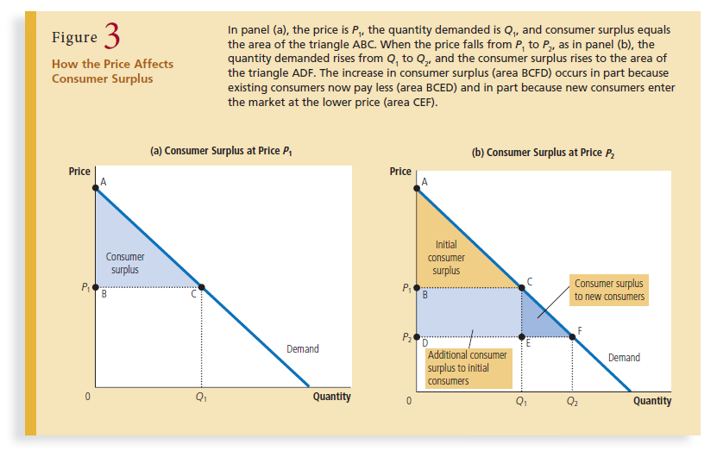

Slide 6
What does consumer surplus measure?
Imagine that you are a policymaker trying to design a good economic system. Would you care about the amount of consumer surplus? Consumer surplus, the amount that buyers are willing to pay for a good minus the amount they actually pay for it, measures the benefit that buyers receive from a good as the buyers themselves perceive it. Thus, consumer surplus is a good measure of economic wellbeing f policymakers want to respect the preferences of buyers. In some circumstances, policymakers might choose not to care about consumer surplus because they do not respect the preferences that drive buyer behavior. For example, drug addicts are willing to pay a high price for heroin. Yet we would not say that addicts get a large benefit from being able to buy heroin at a low price (even though addicts might say they do). From the standpoint of society, willingness to pay in this instance is not a good measure of the buyers’ benefit, and consumer surplus is not a good measure of economic well-being, because addicts are not looking after their own best interests.

Slide 7

Producer Surplus (tender BD)

Slide 8
Producer Surplus
On seeing the tender, companies/organizations send their bids to the government. Each company is willing to offer this if the price received exceeds the cost incurred.
In the beginning the bids may be higher but gradually falls because there is more competition. cost is a measure of the willingness to sell the services. Suppliers are willing to sell only if cost is covered. the job goes to the supplier who can do the work at the lowest cost.
Producer surplus is the amount a seller is paid minus the cost of production. Producer surplus measures the benefit sellers receive from participating in a market.

Slide 9
Producer Surplus from Supply Curve
The area below the price and above the supply curve measures the producer surplus in a market. The logic is straightforward: The height of the supply curve measures sellers’ costs, and the difference between the price and the cost of production is each seller’s producer surplus. Thus, the total area is the sum of the producer surplus of all sellers.

Slide 10
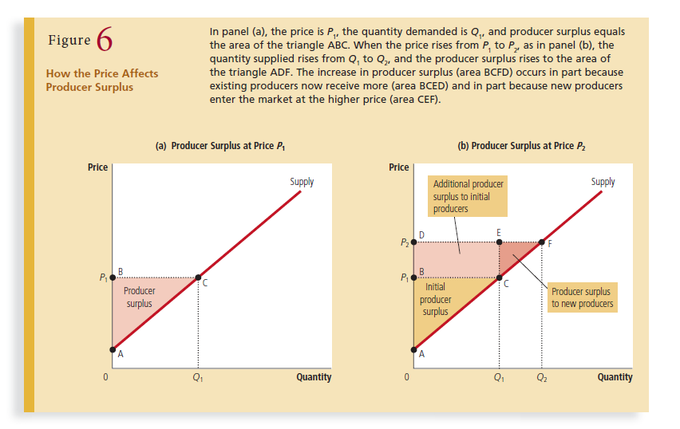

Slide 11
Panel (b) shows what happens when the price rises from P1 to P2. Producer surplus now equals area ADF. This increase in producer surplus has two parts. First, those sellers who were already selling Q1 of the good at the lower price P1 are better off because they now get more for what they sell. The increase in producer surplus for existing sellers equals the area of the rectangle BCED. Second, some new sellers enter the market because they are willing to produce the good at the higher price, resulting in an increase in the quantity supplied from Q1 to Q2. The producer surplus of these newcomers is the area of the triangle CEF. As this analysis shows, we use producer surplus to measure the well-being of sellers in much the same way as we use consumer surplus to measure the wellbeing of buyers. Because these two measures of economic welfare are so similar, it is natural to use them together.

Slide 12
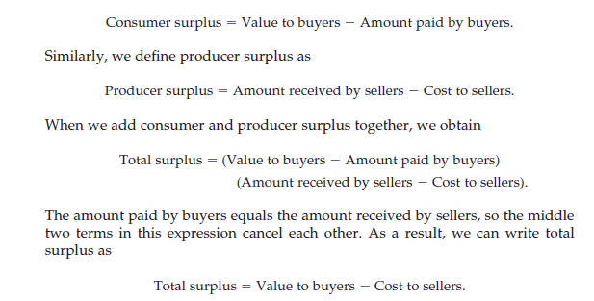

Slide 13
Implications for Surpluses
Total surplus in a market is the total value to buyers of the goods, as measured by their willingness to pay, minus the total cost to sellers of providing those goods. If an allocation of resources maximizes total surplus, we say that the allocation exhibits efficiency. If an allocation is not efficient, then some of the potential gains from trade among buyers and sellers are not being realized.

Slide 14
Efficiency..?
an allocation is inefficient if a good is not being produced by the sellers with lowest cost. In this case, moving production from a high-cost producer to a low-cost producer will lower the total cost to sellers and raise total surplus. Similarly, an allocation is inefficient if a good is not being consumed by the buyers who value it most highly. In this case, moving consumption of the good from a buyer with a low valuation to a buyer with a high valuation will raise total surplus. In addition to efficiency, the social planner might also care about equality— that is, whether the various buyers and sellers in the market have a similar level of economic well-being. In essence, the gains from trade in a market are like a pie to be shared among the market participants. The question of efficiency concerns whether the pie is as big as possible. The question of equality concerns how the pie is sliced and how the portions are distributed among members of society. In this chapter, we concentrate on efficiency as the social planner’s goal. Keep in mind, however, that real policymakers often care about equality as well.

Slide 15
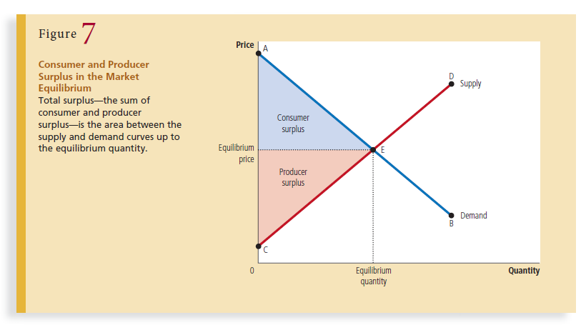

Slide 16
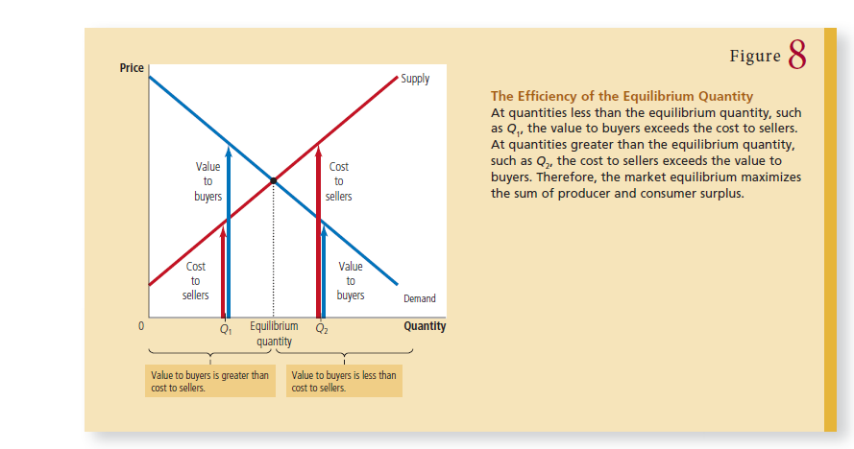
Read page 146-151

Slide 17
The application of Taxes (Mankiw, 8 Powell, 5)
When a tax is levied on buyers, the demand curve shifts downward by the size of the tax; when it is levied on sellers, the supply curve shifts upward by that amount. In either case, when the tax is enacted, the price paid by buyers rises, and the price received by sellers falls. In the end, the elasticities of supply and demand determine how the tax burden is distributed between producers and consumers.
Figure 1 shows these effects. To simplify our discussion, this figure does not show a shift in either the supply or demand curve, although one curve must shift. Which curve shifts depends on whether the tax is levied on sellers (the supply curve shifts) or buyers (the demand curve shifts). In this chapter, we can keep the analysis general and simplify the graphs by not bothering to show the shift. The key result for our purposes here is that the tax places a wedge between the price buyers pay and the price sellers receive.

Slide 18
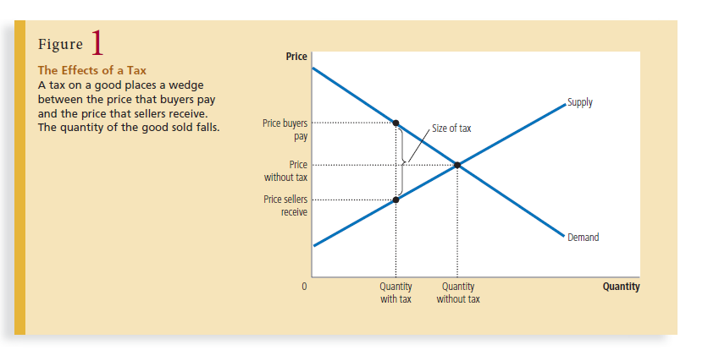

Slide 19
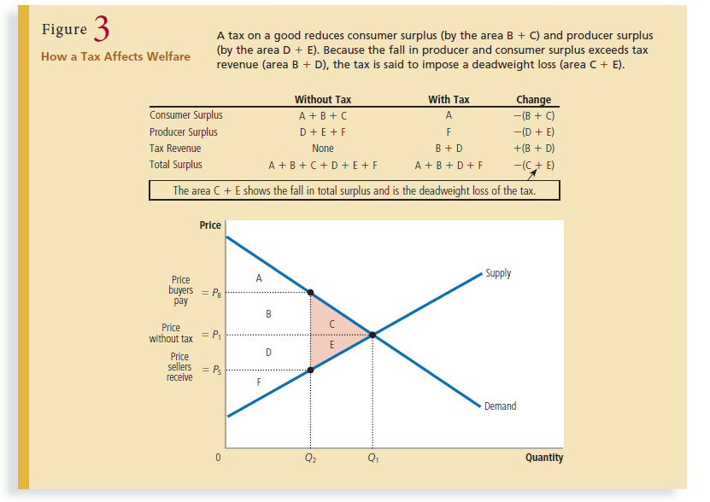

Slide 20
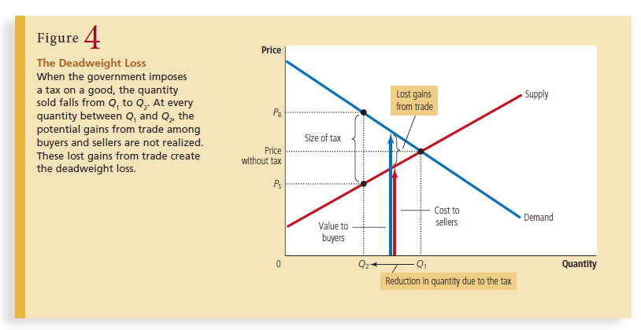

Slide 21
Draw the supply and demand curves for cookies. If the government imposes a tax on cookies, show what happens to the price paid by buyers, the price received by sellers, and the quantity sold. In your diagram, show the deadweight loss from the tax. Explain the meaning of the deadweight loss.

Slide 22
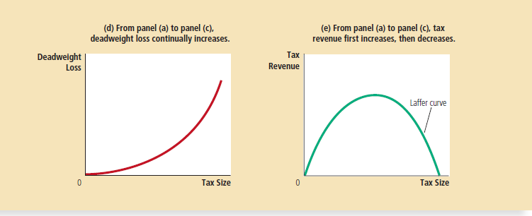
DOES TAX ALWAYS IMPROVE EFFICIENCY?

Slide 23
What restricts efficiency?
Obstacles to Efficiency: although markets generally do a good job at sending resources to where they are most highly valued, they do not always get it right. Sometimes, markets produce too much of a good or service, and sometimes they produce too little. The most significant obstacles to achieving an efficient allocation of resources in a market economy are:
Price ceilings and price floors
Taxes, subsidies and quotas
Monopoly
External costs and external benefits
Public goods and common resources

Slide 24
Price Ceilings and Price Floors
Concept of Price Ceilings and Price Floors?
Government Intervention to correct Market Inefficiency. Tackle black markets?

Slide 25
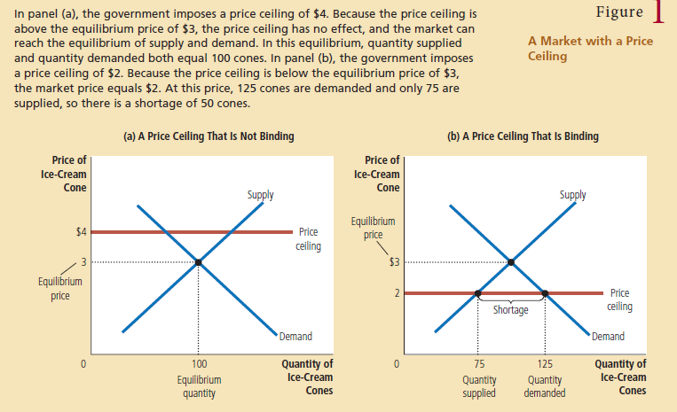

Slide 26
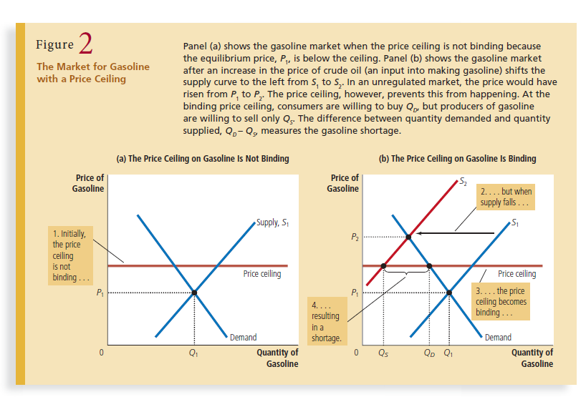

Slide 27
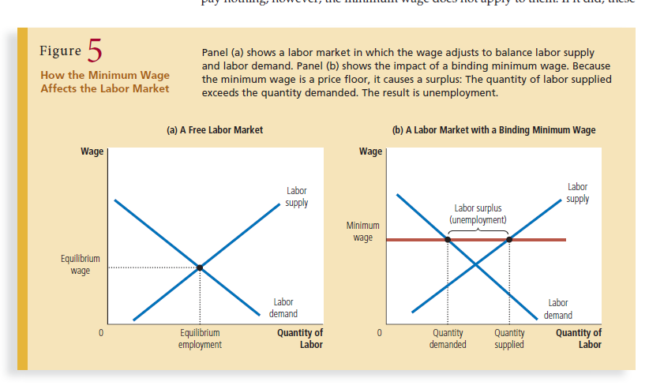
Minimum wage market

Slide 28
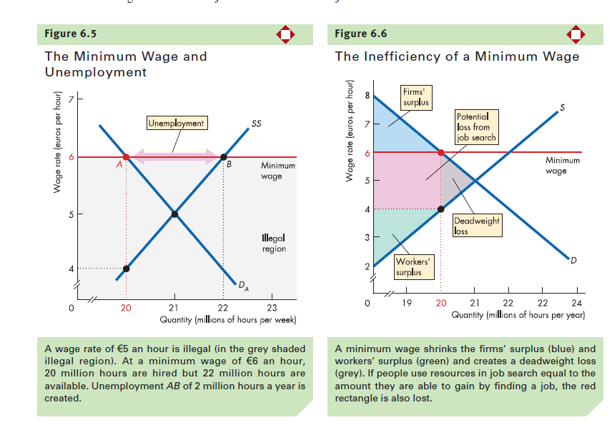

Slide 29
The debate about Minimum Wage
The minimum wage is a frequent topic of debate.
The minimum wage in Bangladesh is:
The existing minimum monthly wage of Tk 5,300 or almost $65 came into effect from Jan 1, 2014 compared to UK’s 9.99 (1000 BDT) pounds per hour.
Advocates of the minimum wage view the policy as one way to raise the income of the working poor. They correctly point out that workers who earn the minimum wage can afford only a meager standard of living. Many advocates of the minimum wage admit that it has some adverse effects, including unemployment, but they believe that these effects are small and that, all things considered, a higher minimum wage makes the poor better off.

Slide 30
Opponents of the minimum wage contend that it is not the best way to combat poverty. They note that a high minimum wage causes unemployment, encourages teenagers to drop out of school, and prevents some unskilled workers from getting the on-the-job training they need. Moreover, opponents of the minimum wage point out that it is a poorly targeted policy. Not all minimum-wage workers are heads of households trying to help their families escape poverty. In fact, fewer than a third of minimum-wage earners are in families with incomes below the poverty line. Many are teenagers from middle‑class homes working at part-time jobs for extra spending money.

